Slide 1

ECEN 5833
Low Power Embedded Design Techniques
Presented by
Team Vega Jithendra HS, Prudhvi Kondapalli, Vishwas Navada

Slide 2

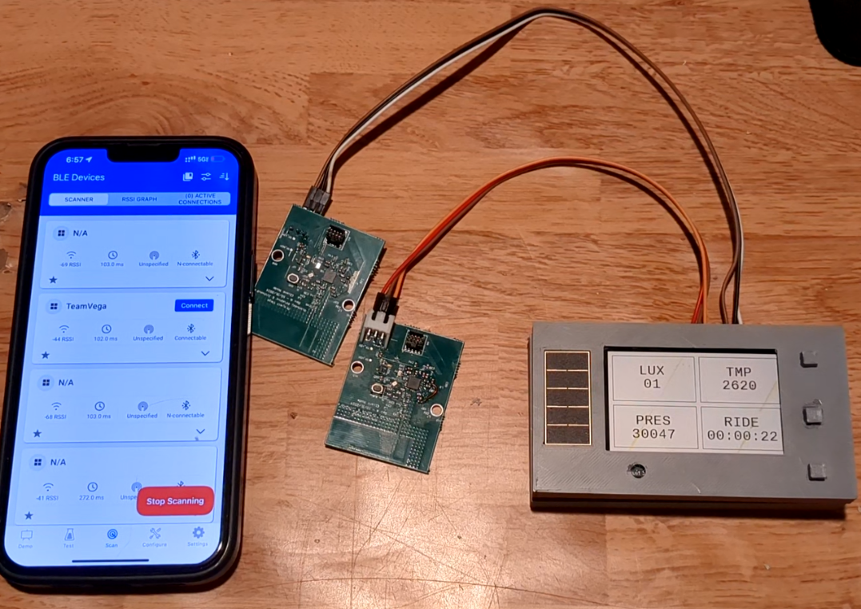

Agenda
Project Description & Use Cases
System Block Diagram
Low Power Mode Timeline
Hardware Design block diagram
Hardware Characterization
Software Design block diagram
Proof of Concept Implementation
Summary and Lessons Learned

Slide 3
Project Description & Use Cases
The device can be used to
The idea was to design a low-powered bike computer to assist the user with information like
Distance covered and ride speed
Cadence
Elevation
Trail duration
Luminosity for weather monitoring
Pressure and Temperature (Local to the device)
IMU Data (Stretch Goal)
Both on an app and the device LCD Screen
Emphasis on low power – uW per day, the user can use it for --- days with one charge
This device can be used for Urban Commuting, Mountain Trail Exploration, Performance Training, Recreational Cycling

Slide 4
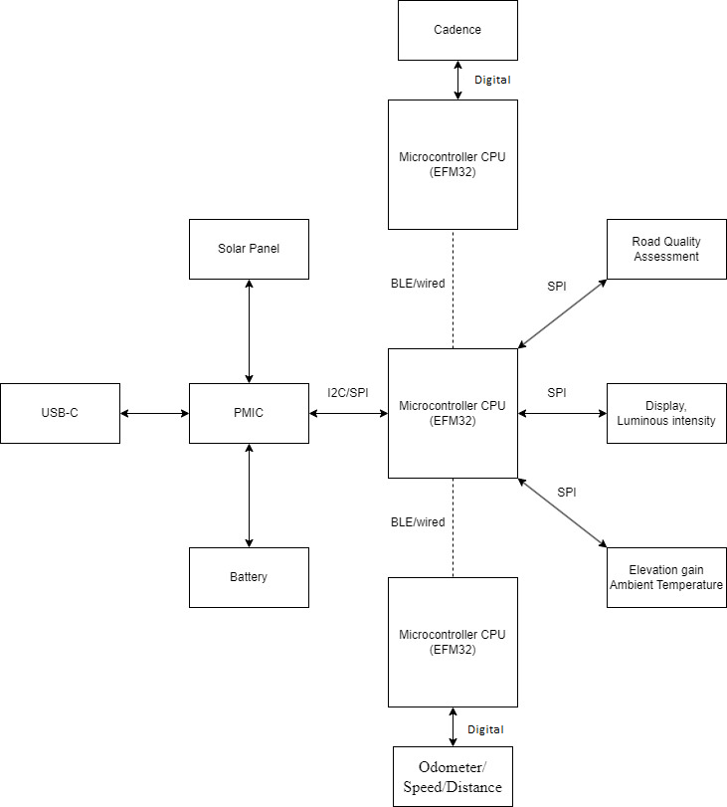
System Block Diagram
GATT Services
Lux State Service
Pressure State Service
Temperature State Service
IMU State Service
Ride State Service
Needs to deal with around 4 interrupts per second at the least, BLE with 5 services, 7 Characteristics and a lot of data.
The EFM32 BG21 serves as the principal node, leveraging its extensive 1024 KB flash memory and 96 kB RAM.
The client node is a lightweight sensor interface designed to transmit digital signals from the Hall effect sensor via Bluetooth Low Energy (BLE) communication.
The BQ25570 Power Management Integrated Circuit (PMIC) manages solar and battery power, providing a 3V supply for the microcontroller and boosting to 5V for the display.

Slide 5
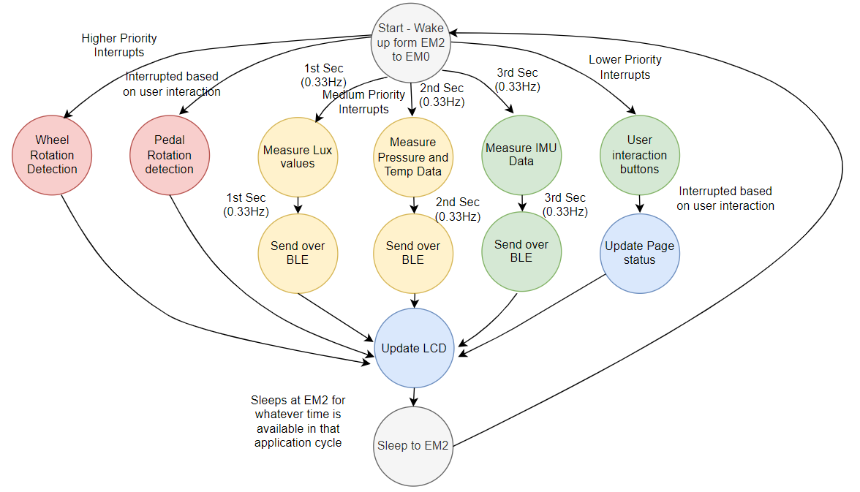
Power Mode Timeline
Main reason we don’t see huge power saving

Slide 6
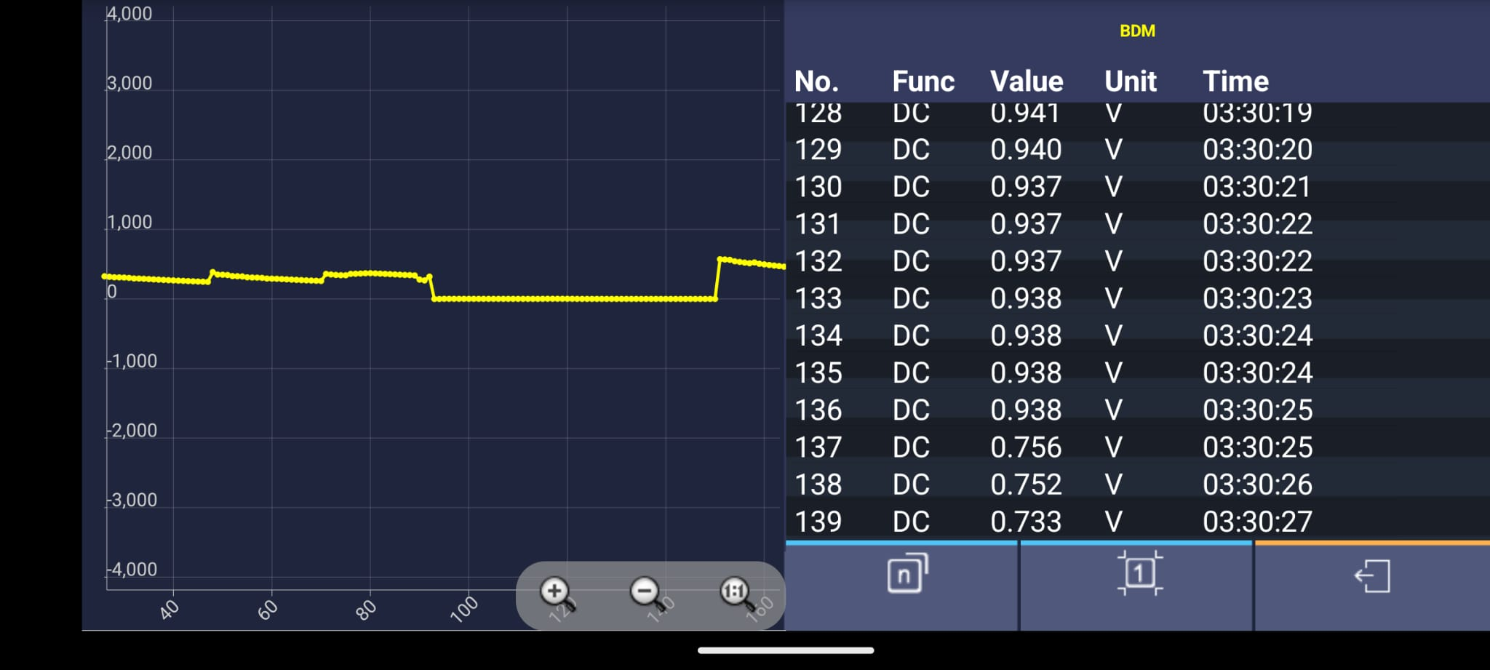
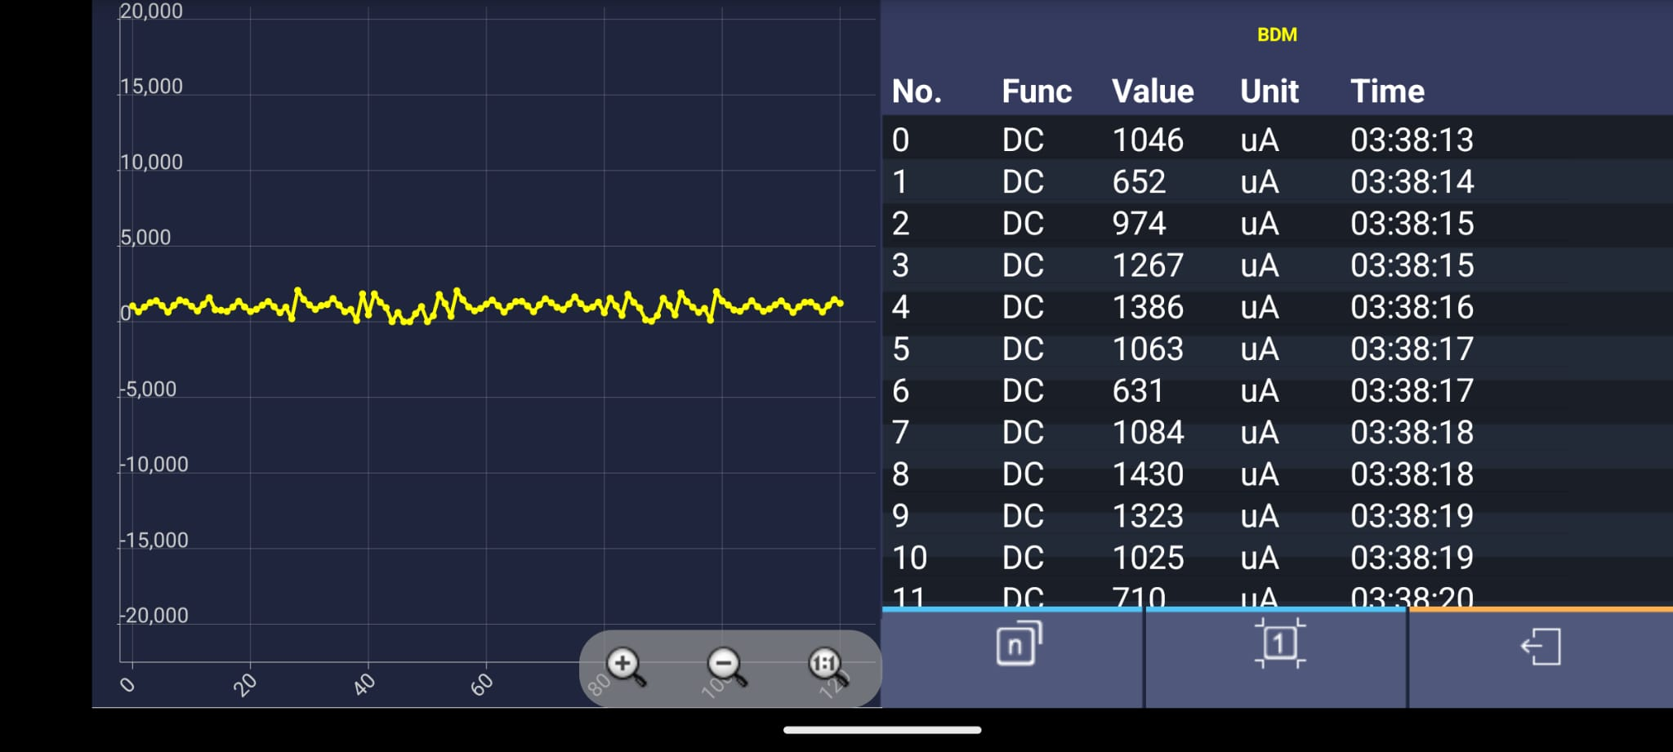

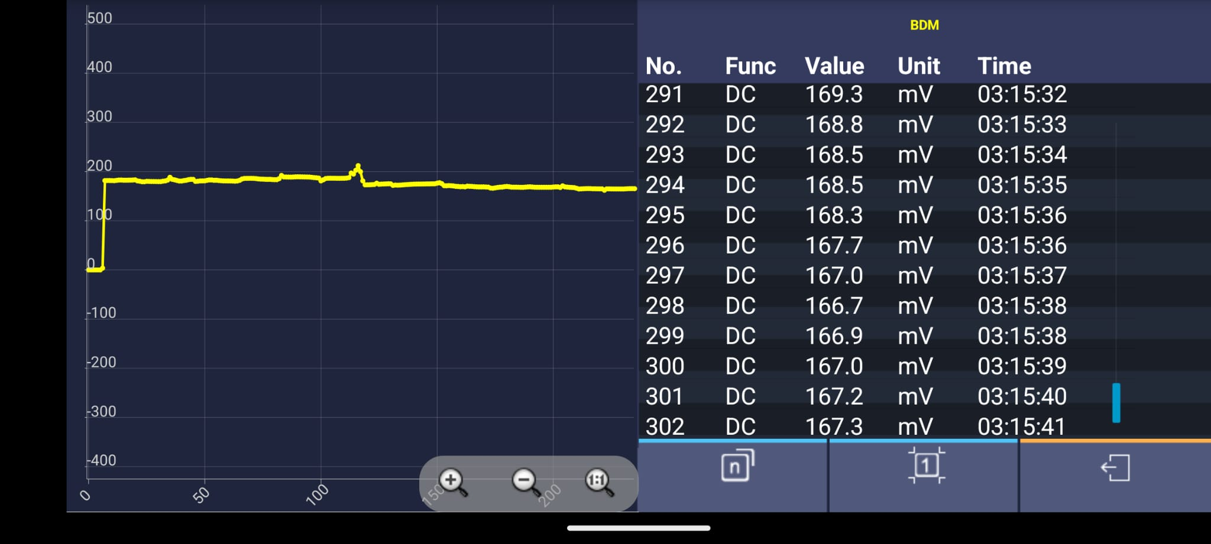
Hardware Characterization
Energy Harvester Voltage (Solar Panel)
Energy Harvester Current (Solar Panel)
This shows battery can be fully charged eventually
Expected Time to fully charge the battery using Solar – Too small to calculate (depends on harvester)
(Measured across 1 ohm resistor – reason for mV)
Expected Time to fully charge the battery using USB – 3 Hours
USB Charging Voltage (through PMIC)
USB Charging Current (through PMIC)

Slide 7
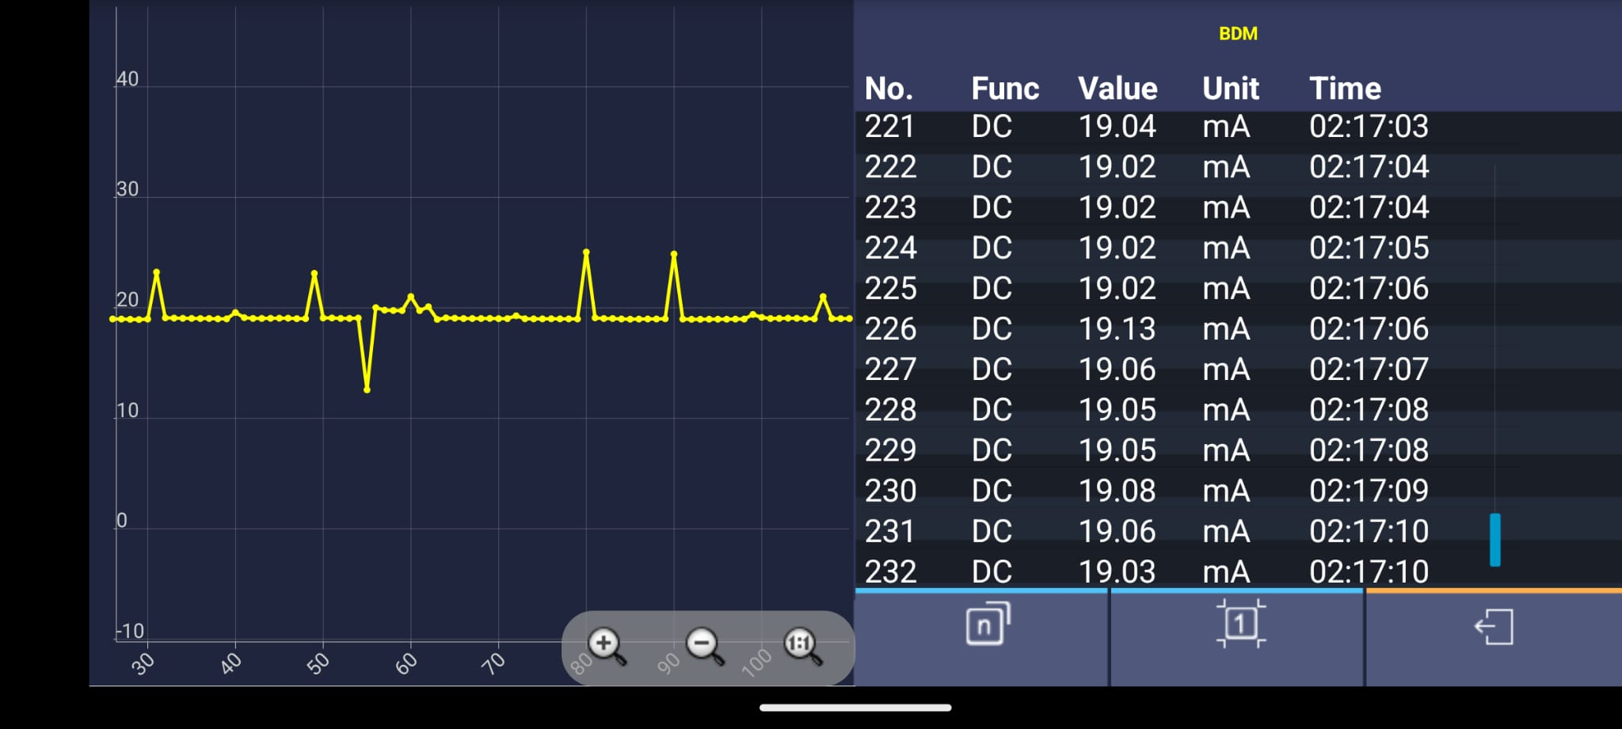
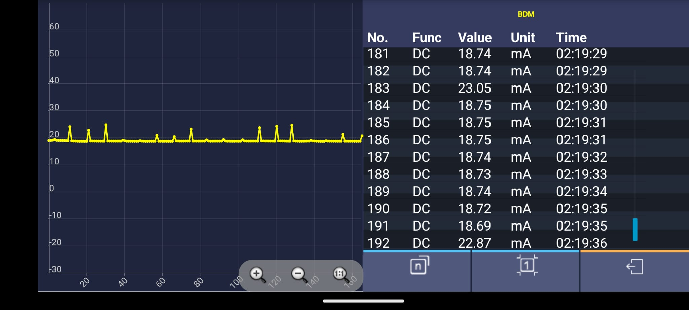
Hardware Characterization
Initial Power Analysis
Total Energy Required for 4 hrs usage and 18 hours deep sleep per day = 32 mWh
Predicted battery life = 31 days
Actual Power Analysis
Total Energy Required for 4 hrs usage and 18 hours deep sleep per day = 19mA*3.3V = 240 mWh
Battery life = 20 days
Reasons for Mismatch – Real Time Clock Display feature, continuous wheel and pedal interrupts and extra hardware on LCD module
Avg Normal Current Consumption of device
Current consumptions during BLE Notifications
Radio Transmission
Lux over BLE
Lux over BLE
Temp and Pres over BLE
Temp and Pres over BLE
IMU data
IMU data
Radio Reception Read Command from app

Slide 8
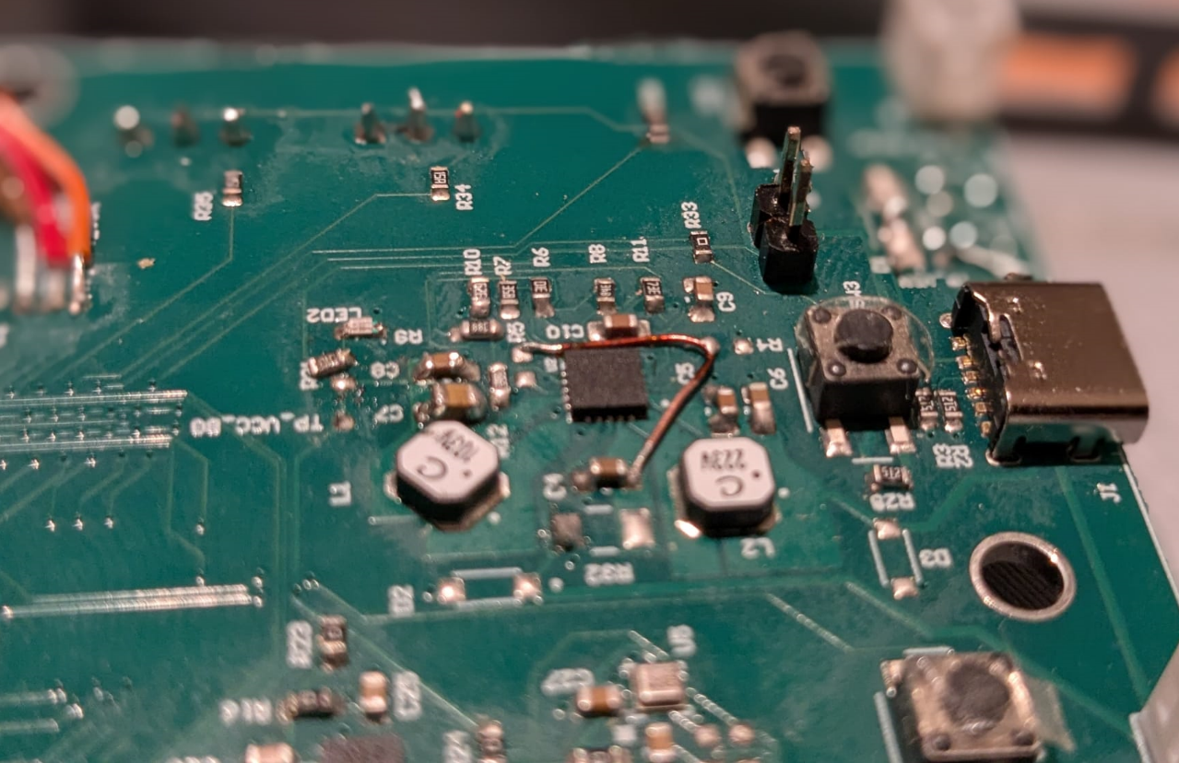
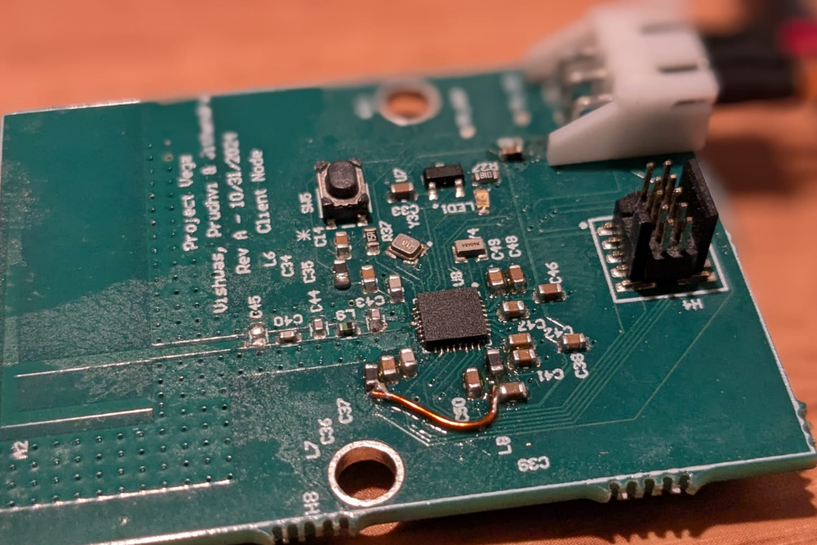
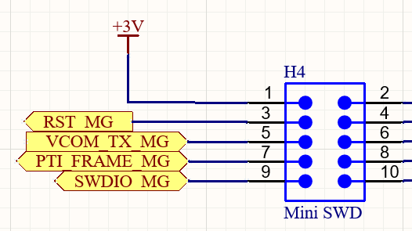
Hardware Bugs / Design/ Bring Up issues
Principal Node
VSTORE and VOUT enable were not connected in the PMIC circuitry, and the external wiring were made as we see in the top image.
The net label VDCDC output from the microcontroller to the RF module VCC was not connected properly in the schematics, resulting in a missing connection and boot load issues.
The PTI_FRAME and SWDIO pins were swapped in the SWD mini connector of a client node, which also caused boot load problems.
Client Node

Slide 9
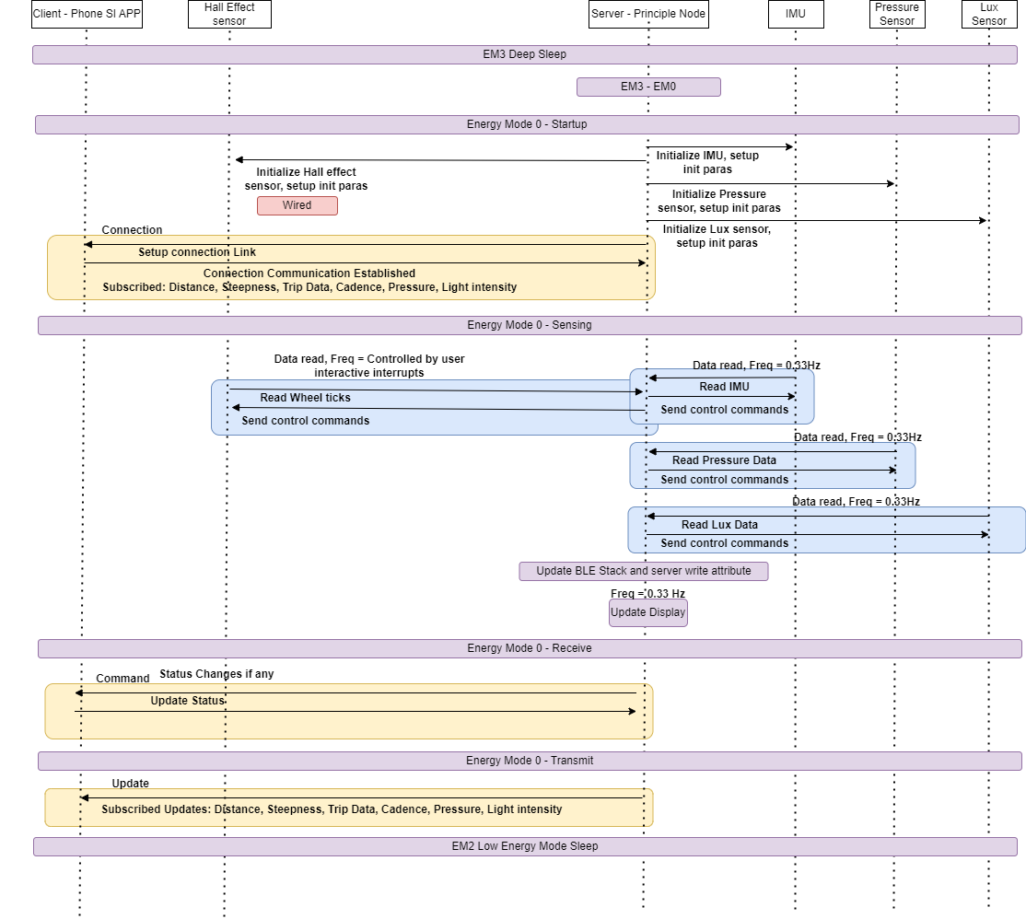
Software Design UML Flow Diagram

Slide 10
Proof-of-concept Realization
Objective | Status | Remarks
PMIC delivering 3.3V to micro controller and managing solar and battery | Working | Measured voltages at each test points
Principal node BLE communication | Working | Tested with SI connectivity app
Client node BLE communication | Not working | Not able to find the root cause
Sensors reading | Working
Finite state machine and power modes | Working | Capable to Switch between EM0,EM1 and EM2
Show measured readings on display | Working | Refresh rate is adjusted to 0.33Hz due to FSM instead of 1Hz

Slide 11
Lessons were learned in the following areas:
Load power management (PMIC, Boost converter)
Selection of components (R, L, and C tolerance)
Battery selection and analysis of discharge curves
RF antenna design and optimization
Low-power sensors and their operating modes
Hardware bring-up and modular debugging
Bootloading and firmware development

Slide 12
Thank you Questions?

